Slide 1
Northwind sales data analysis

Slide 2
OVERVIEW
.
Northwind is a fictional business specializing in a variety of products, including Beverages, Condiments, Confections, Dairy Products, Cereals, Meat, Produce, and Seafood. The dataset includes files such as Categories, Customer Details, Employee Details, Order Details, Orders, and Products. Question were provided to query the dataset.

Slide 3

Tool used to analysis northwind sales sql server management studio 18

Slide 4
Tables in northwind sales analysis
dbo.orders
dbo.products
dbo.suppliers
dbo.shippers
dbo.Categories
dbo.CustomersGroup
dbo.Customers
dbo.employees
dbo.orderdetails

Slide 5
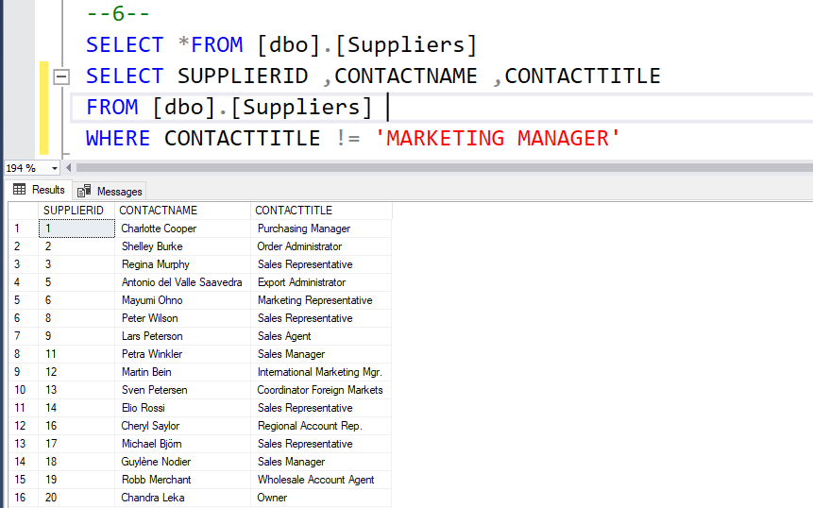
Question: supplier and contact title query: output:

Slide 6
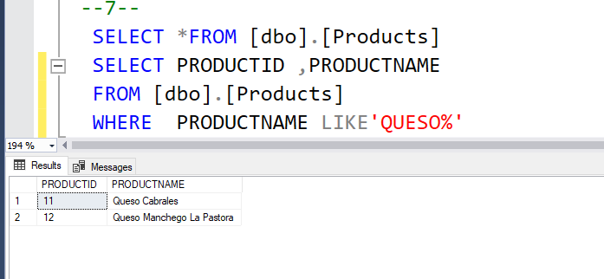
Question: products with “queso” in productname query: output:

Slide 7
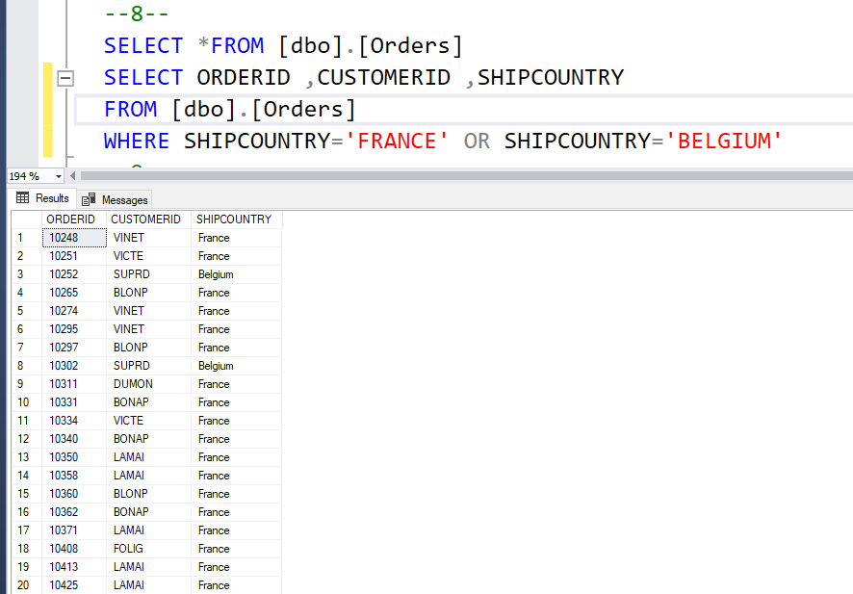
Question: orders shipping to France and Belgium query: output:

Slide 8
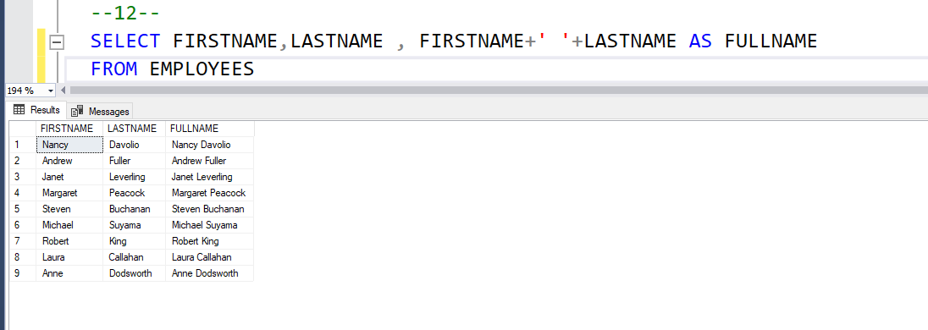
Question: employee full name query: output:

Slide 9
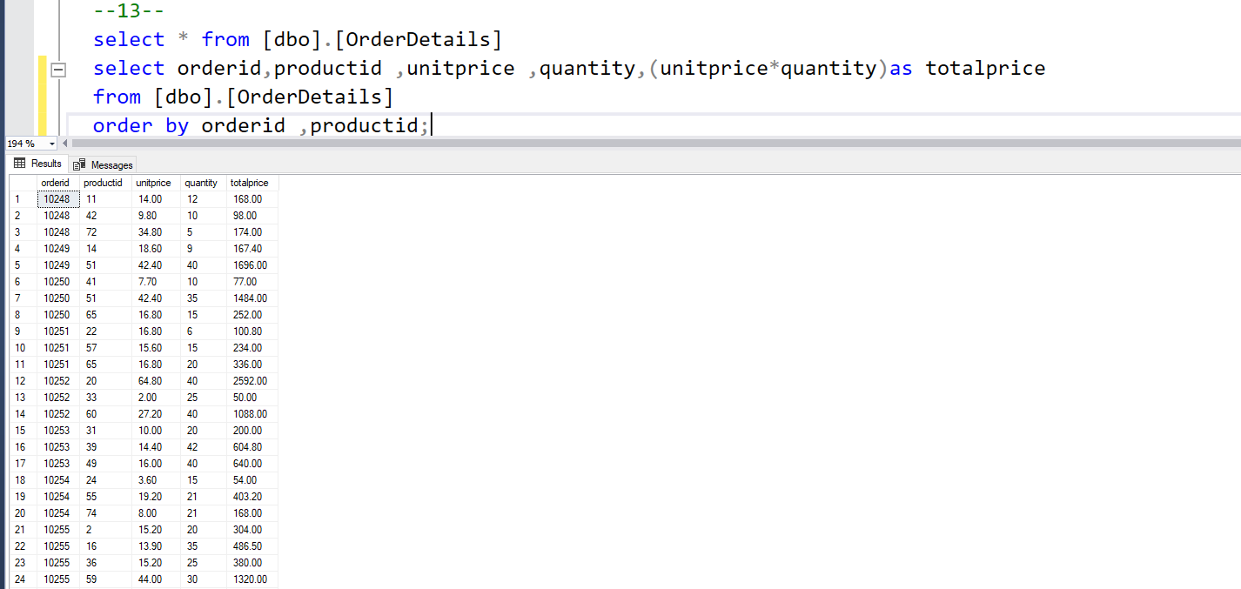
Question: orderdetails amount per line item query: output:

Slide 10
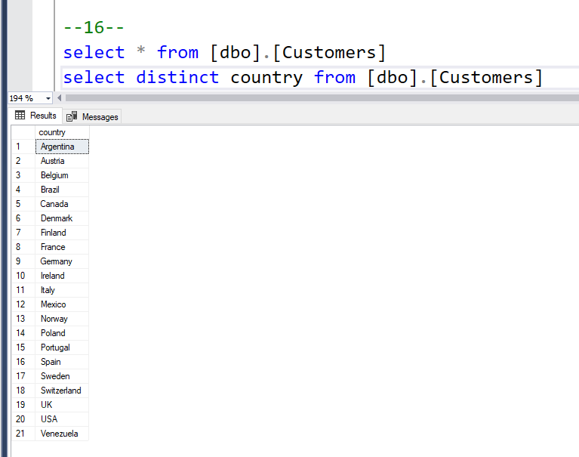
Question: countries where there are customers query: output:

Slide 11
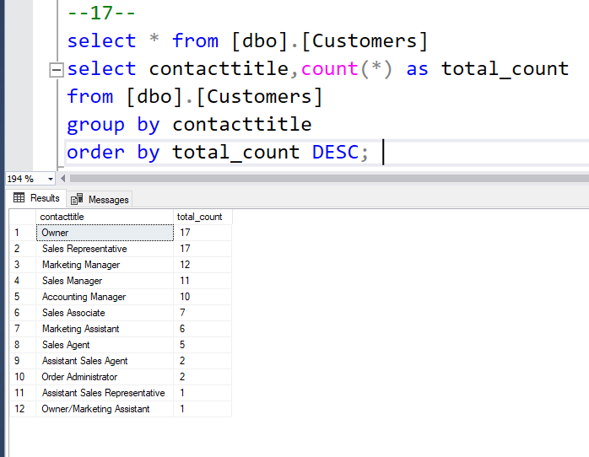
Question: contact titles for customers query: output:

Slide 12
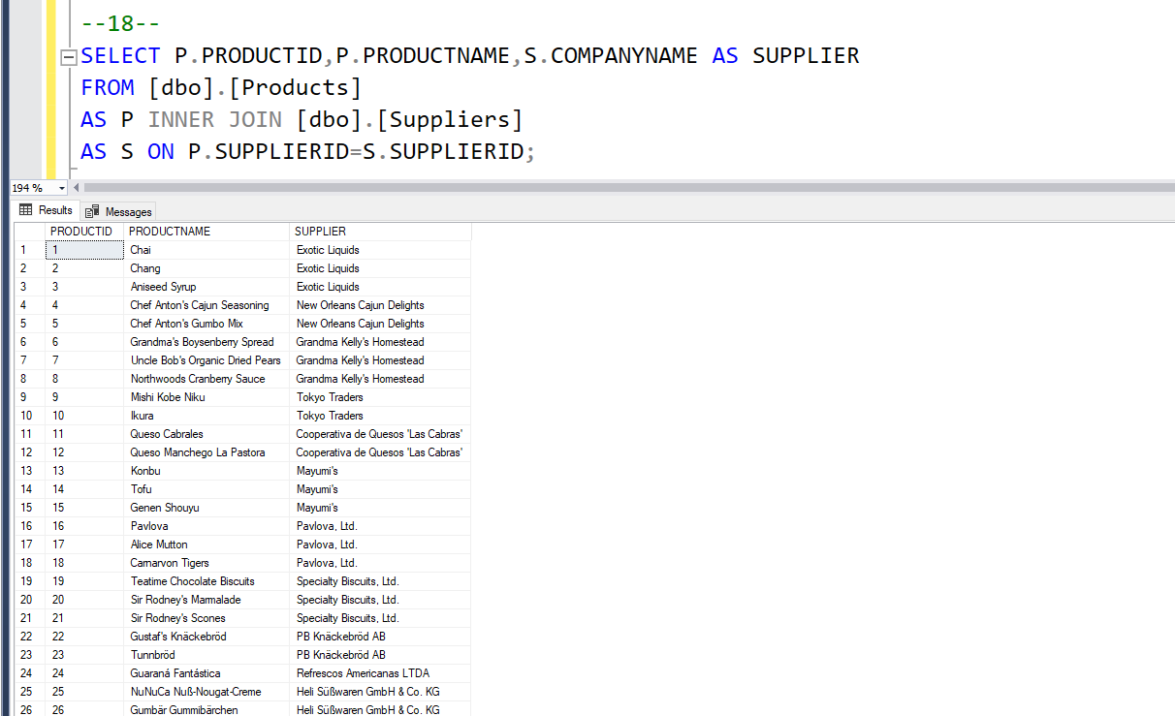
Question: product with associated suppliers name query: output:

Slide 13
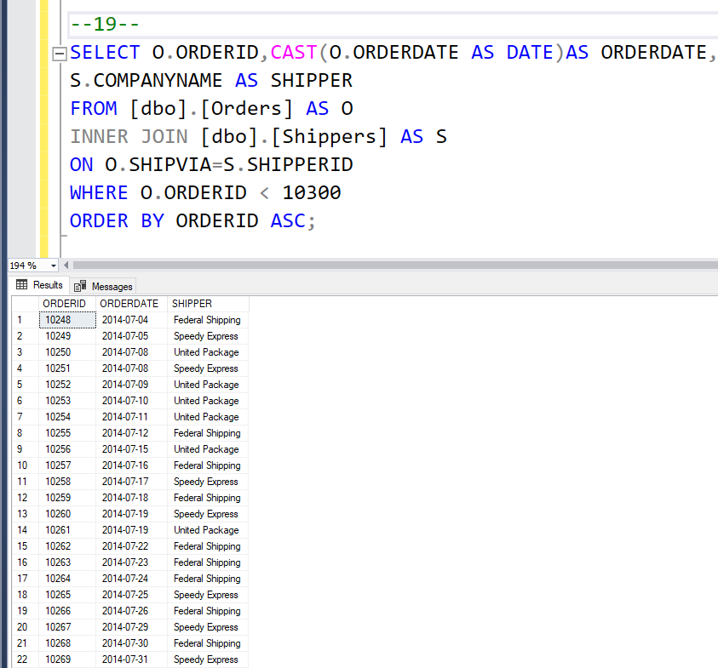
Question: orders and shipper that was used query: output:

Slide 14
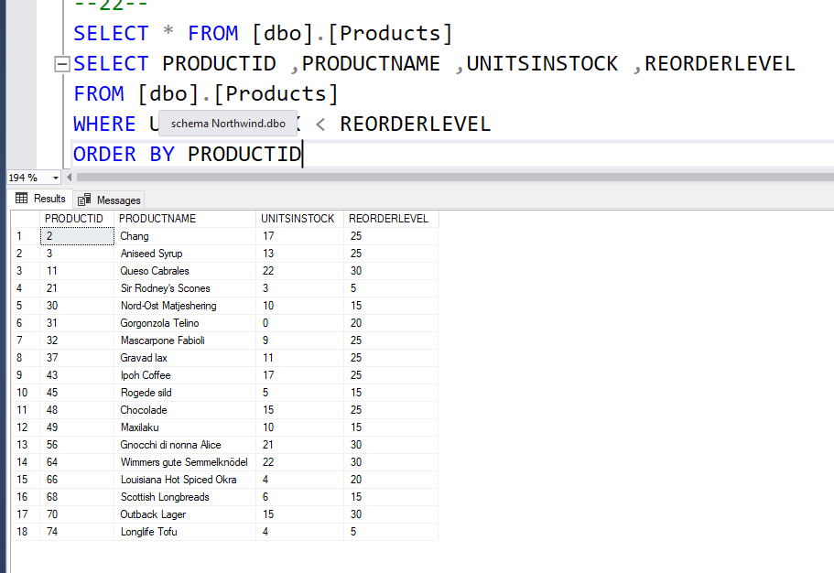
Question: products that need reordering query: output:

Slide 15
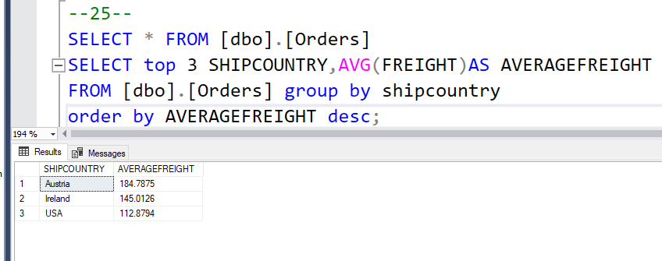
Question: high freight charges query: output:

Slide 16

Thank You!
Keerthana M

